Slide 1

UDACITY
SQL Database Exploration Project

Slide 2
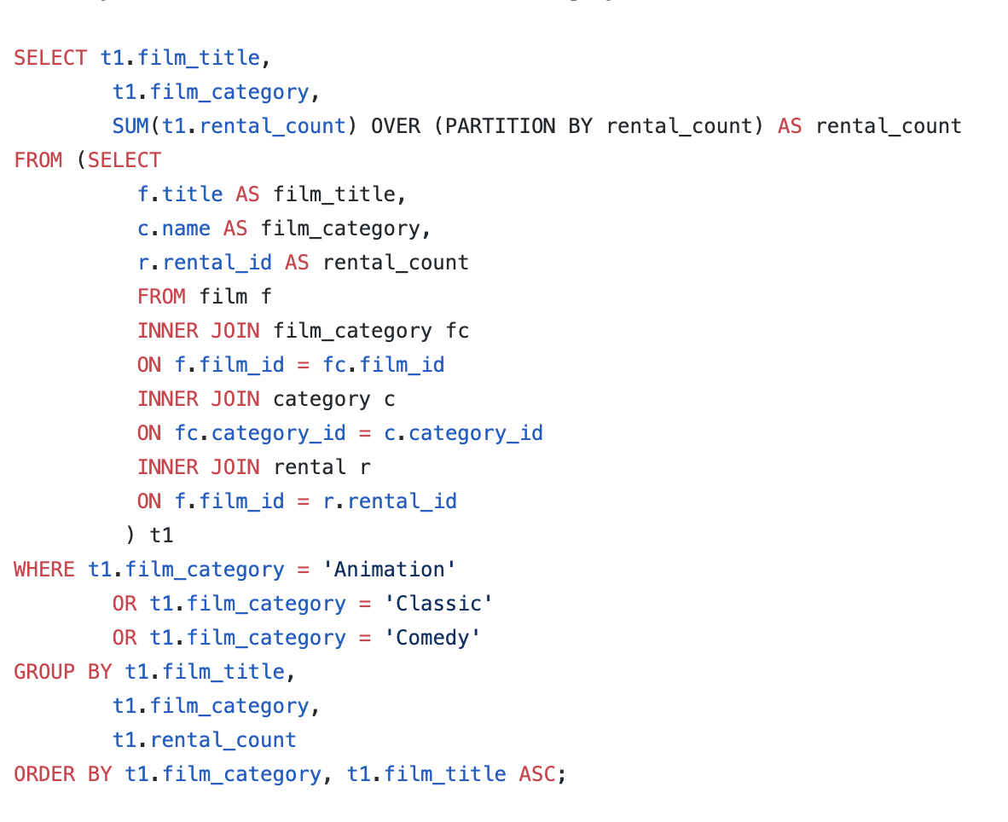
Question 1
We want to understand more about the movies that families are watching. The following categories are considered family movies: Animation, Children, Classics, Comedy, Family and Music.
Create a query that lists each movie, the film category it is classified in, and the number of times it has been rented out.

Slide 3
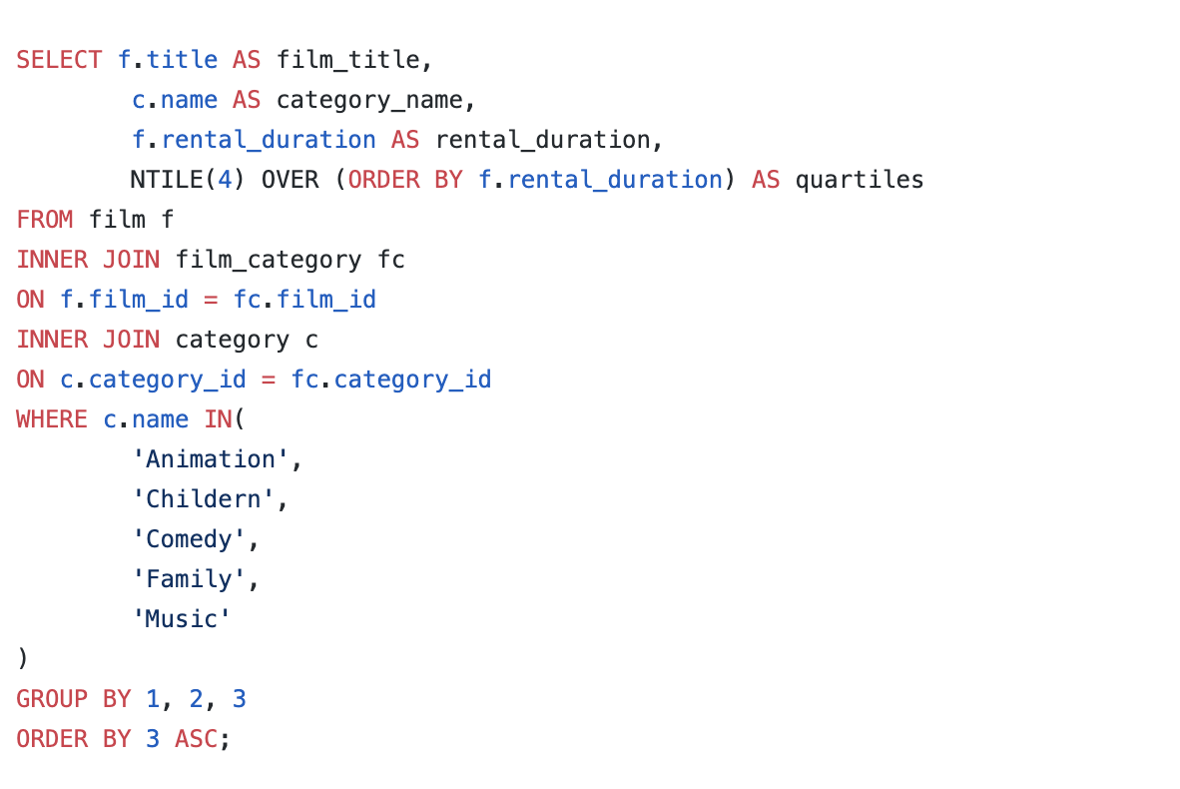
Question 2
Now we need to know how the length of rental duration of these family-friendly movies compares to the duration that all movies are rented for. Can you provide a table with the movie titles and divide them into 4 levels (first_quarter, second_quarter, third_quarter, and final_quarter) based on the quartiles (25%, 50%, 75%) of the rental duration for movies across all categories? Make sure to also indicate the category that these family-friendly movies fall into.
film_title | category_name | rental_duration | quartiles
Alone Trip | Music | 3 | 1
Anaconda Confessions | Animation | 3 | 1
Baked Cleopatra | Family | 3 | 1
Bilko Anonymous | Family | 3 | 1
Blood Argonauts | Family | 3 | 1
Confused Candles | Family | 3 | 1
Doors President | Animation | 3 | 1
Downhill Enough | Comedy | 3 | 1
Earring Instinct | Family | 3 | 1
Ferris Mother | Comedy | 3 | 1

Slide 4
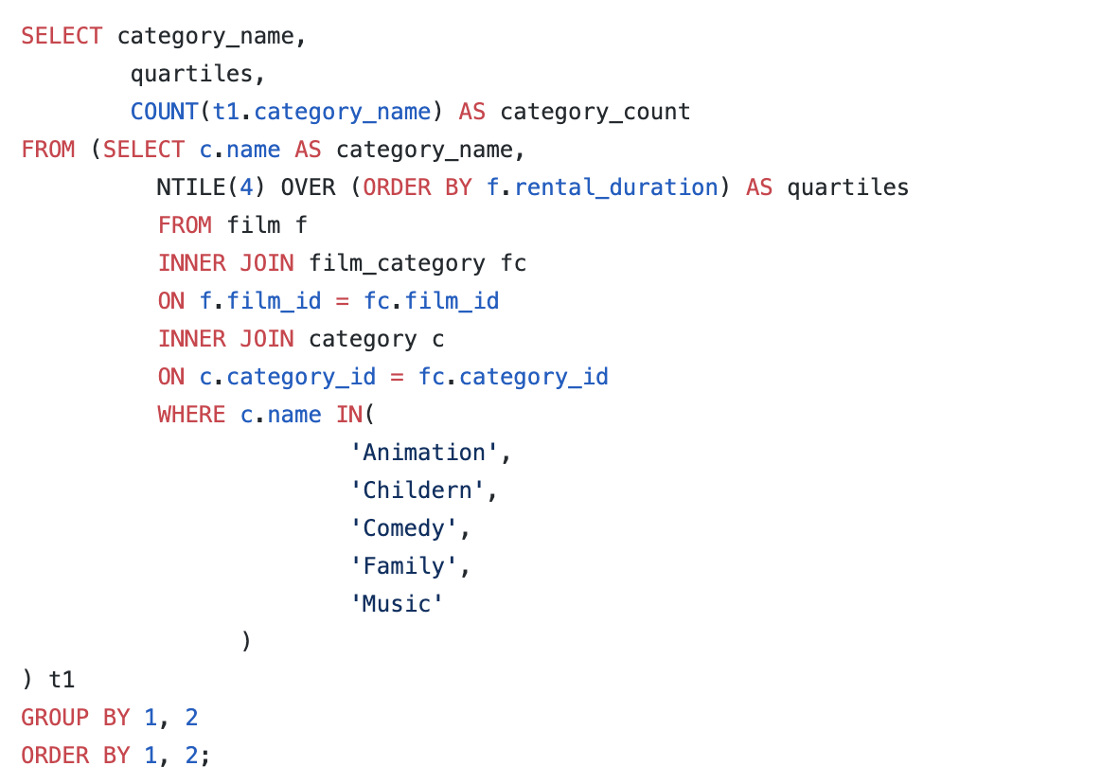
Question 3
Provide a table with the family-friendly film category, each of the quartiles, and the corresponding count of movies within each combination of film category for each corresponding rental duration category.

Slide 5
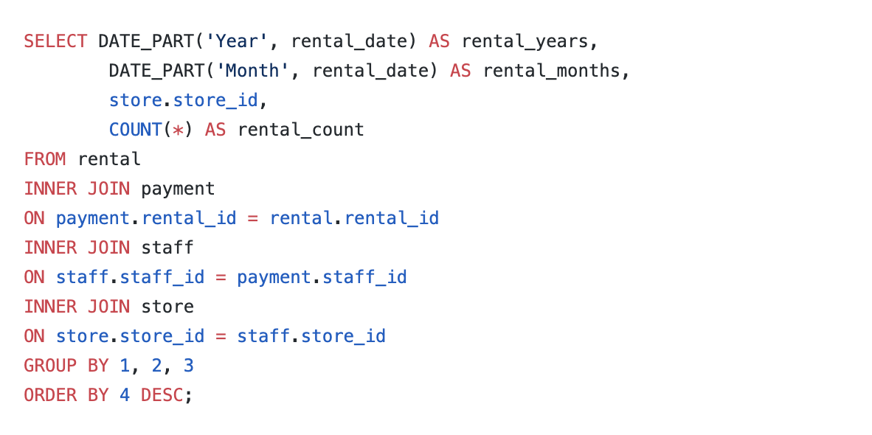
Question 4
find out how the two stores compare in their count of rental orders during every month for all the years we have data for. Write a query that returns the store ID for the store, the year and month and the number of rental orders each store has fulfilled for that month. Your table should include a column for each of the following: year, month, store ID and count of rental orders fulfilled during that month.

